Slide 1
Climate Change In Arizona
By: Nick Satterly

Slide 2
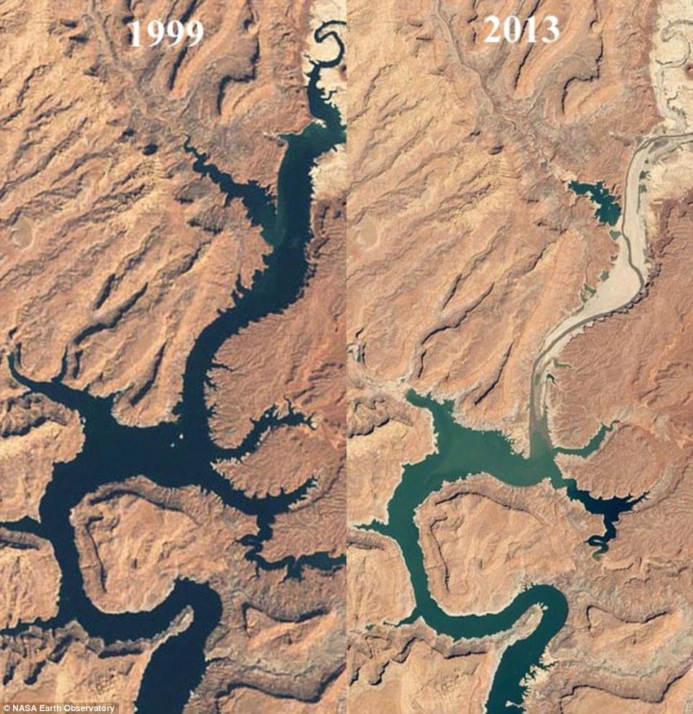
Effect From Drought
Drought in Arizona is getting worse every year, and by the year 2050 it will be above average compared to other states. Although the state is aware of this issue there is very poor planning on how to plan and adapt to account for this change.
This is also a big concern for out main water supply that we share with bordering states creating conflict over the shrinking supply.

Slide 3
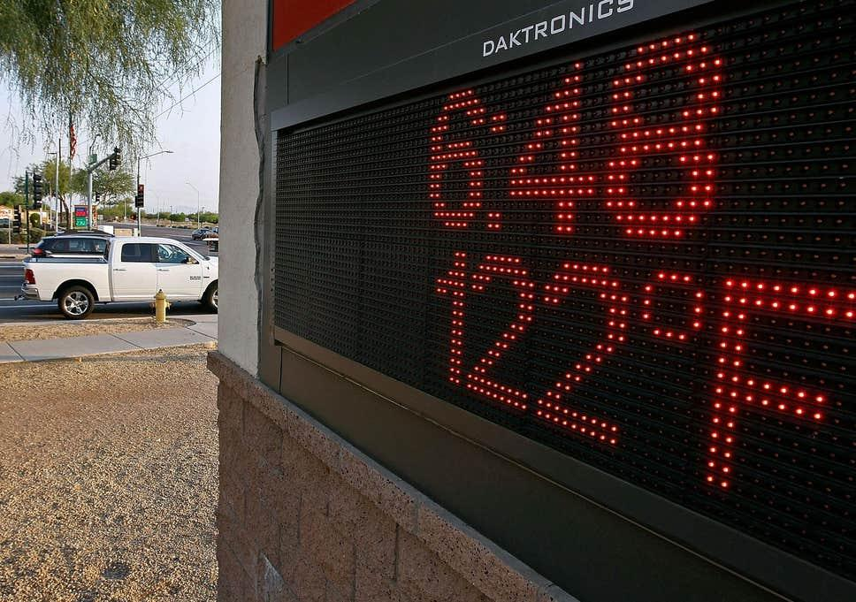
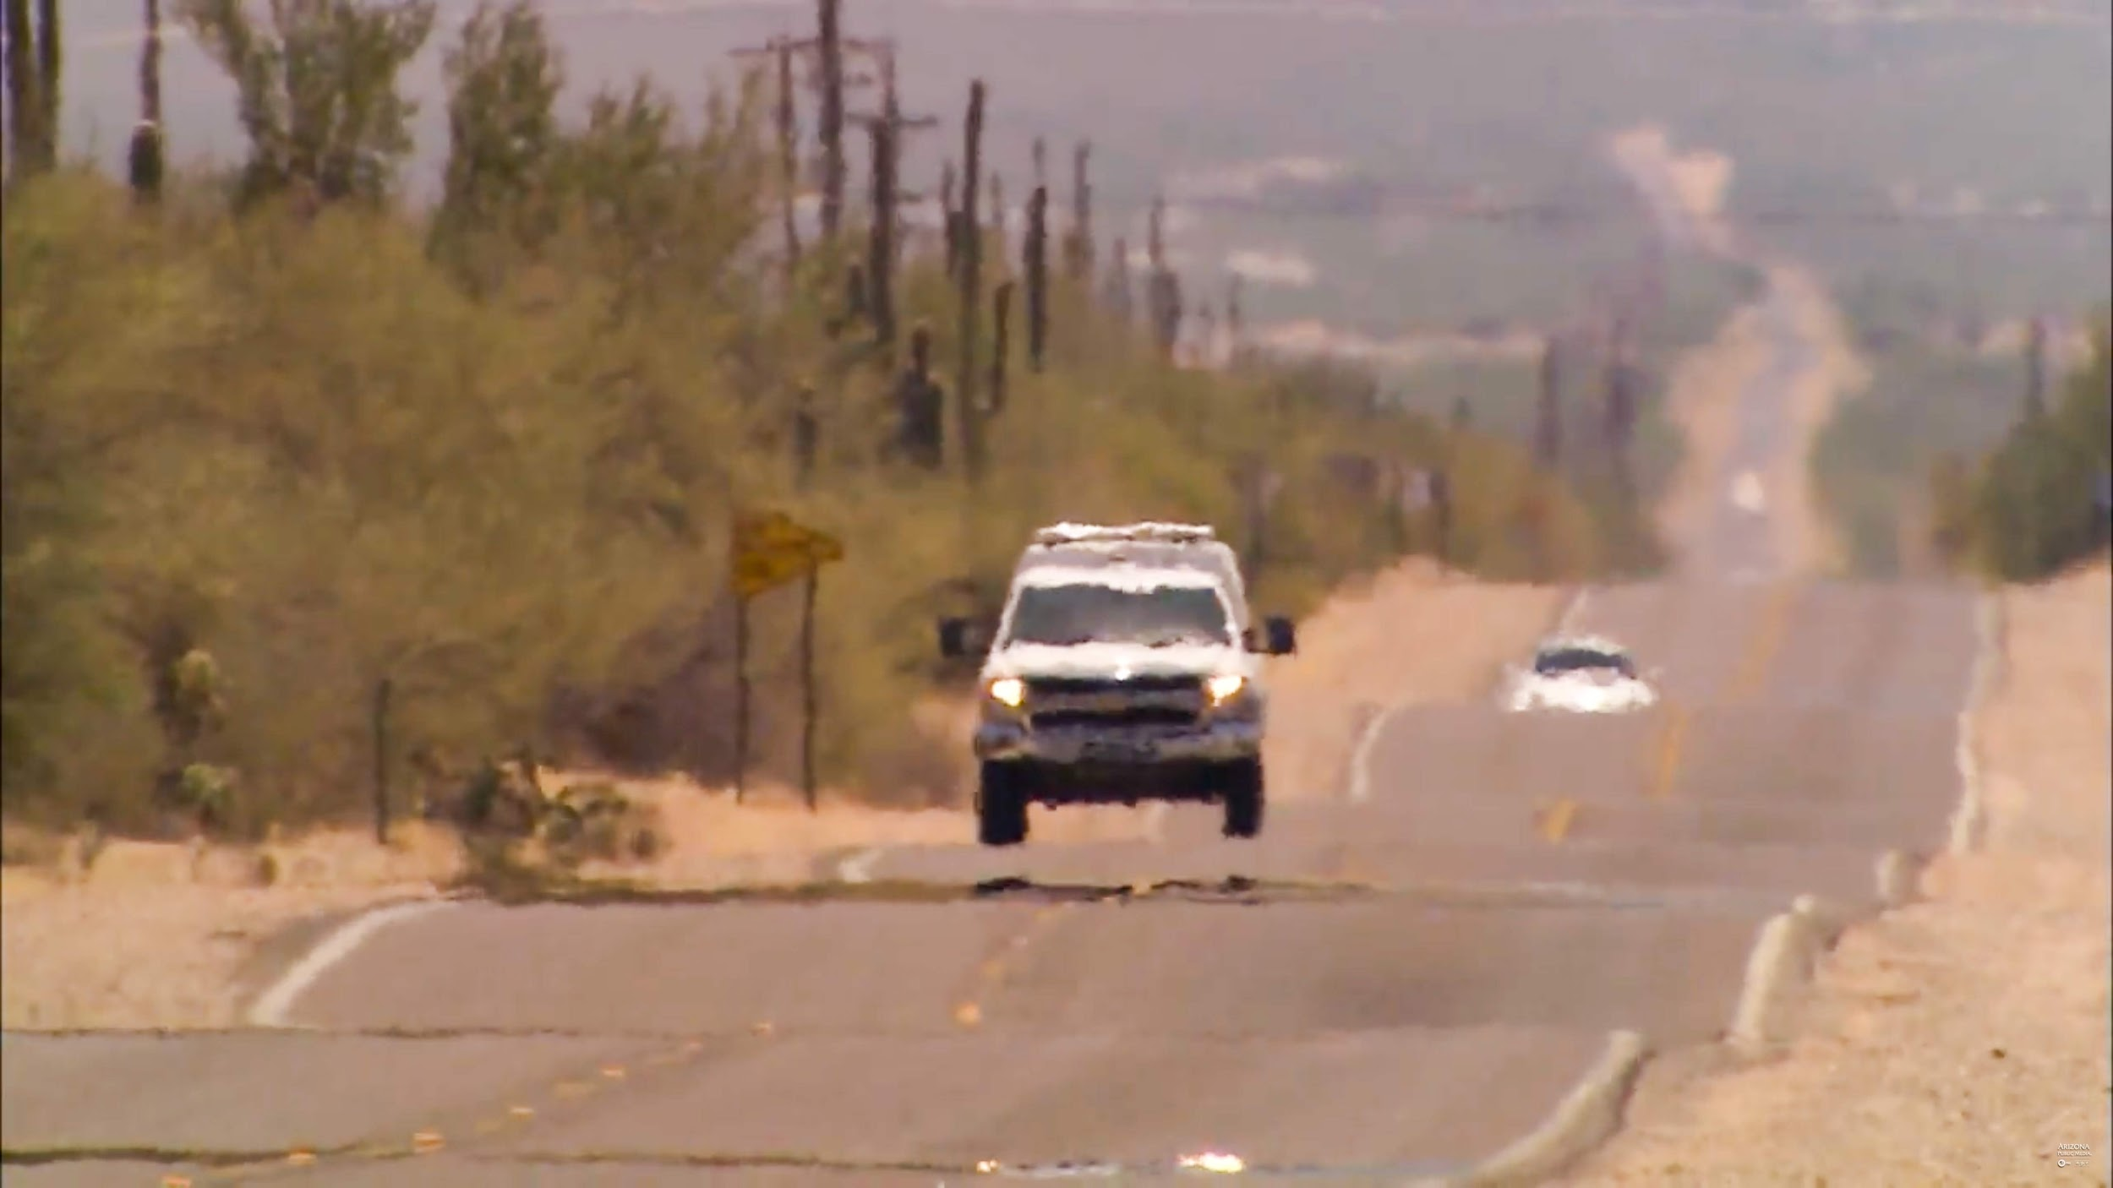
Extreme Heat
Arizona is projected to see heat wave days more than triple by 2050, but it is not yet doing much to plan for and adopt heat-related adaptation measures. It is currently at 15 days but will reach 50 .
The state has taken very little action to create awareness for extreme heat.

Slide 4
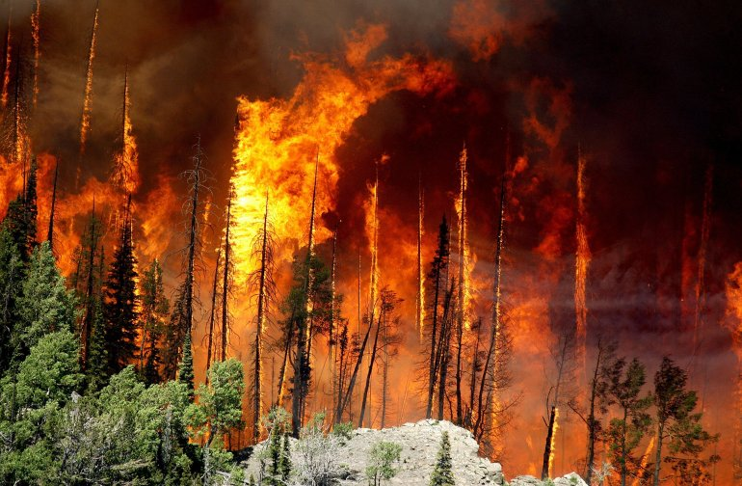
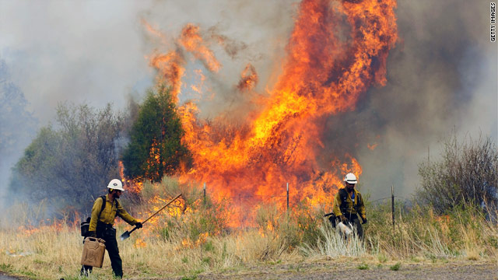
Wildfires
Arizona Wildfires are now among the highest in the nation being the second in the country. Our state is very unprepared for this very high level threat.
Currently there are 80 a year and by 2050 there will be up to 115.
45% of Arizona's population live in danger of wildfires.
Wildfires are result of drought and plant life in Arizona

Slide 5
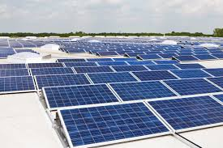
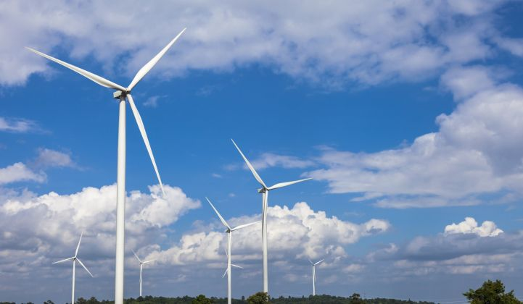
Some Solutions
Ways to take action
Alternative forms of transportation
Conserve more water
Clean energy

Slide 6
Work Cited
https://reportcard.statesatrisk.org/report-card/arizona
https://climatecentral.org
https://www.dailymail.co.uk/news/article-3018740/Who-unplugged-drain-Drought-leaves-bleached-bathtub-ring-canyons-Colorado-River-reservoir-lost-4-4TRILLION-gallons-water.html

